Slide 1

Psychopharmacology: Drugs, the Brain, and Behavior
by Meyer, Farrar, Biezonski, Yates

Slide 2
Chapter 5
Catecholamines
5.1 Catecholamine Synthesis, Release, and Inactivation
5.2 Organization and Function of the Dopaminergic System
5.3 Organization and Function of the Noradrenergic System

Slide 3
Chapter 5
Learning Objectives (1 of 3)
5.1.1 Describe the processes involved in catecholamine synthesis, storage, and release.
5.1.2 Explain how catecholamines are inactivated, including both reuptake and metabolism.
5.1.3 List and explain the clinical uses of drugs that act on catecholamine reuptake or metabolism.

Slide 4
Chapter 5
Learning Objectives (2 of 3)
5.2.1 Name the major ascending dopaminergic pathways that originate in the midbrain, and identify the locations of the cell bodies and the projection areas of each pathway.
5.2.2 Explain the role of DA in behavioral regulation, including the initiation and control of voluntary movement, responses to rewarding stimuli, and cognitive functioning.
5.2.3 Describe the family of DA receptors, including the various subtypes, signaling mechanisms, and roles as both postsynaptic receptors and autoreceptors.
5.2.4 Describe the behavioral and physiological effects of DA receptor agonists and antagonists, including their clinical applications where relevant.

Slide 5
Chapter 5
Learning Objectives (3 of 3)
5.3.1 Identify the primary source of forebrain NE, the main target areas innervated by noradrenergic fibers, and the physiological effects of peripheral NE originating in the sympathetic nervous system and the adrenal glands.
5.3.2 List the adrenergic receptor subtypes and their respective signaling mechanisms.
5.3.3 Explain the mechanisms by which the noradrenergic system helps regulate anxiety, arousal, cognition, and the consolidation of emotional memories.
5.3.4 Identify medical conditions or disorders that can be treated with peripherally acting noradrenergic drugs, and name the drugs used for these disorders.

Slide 6
Catecholamine Synthesis, Release, and Inactivation (1 of 11)
Catecholamines are monamines: a catechol + amine group
  Dopamine (DA)
  Norepinephrine (NE)
  Epinephrine (EPI)
Adjective forms: dopaminergic, noradrenergic, and adrenergic
Adrenal medulla secretes EPI and NE into the bloodstream where they act as hormones.
Notes:
Instructor Notes:
Biogenic amines – made by living organisms
Monoamines (transmitters that have ne amine group)

Slide 7
Catecholamine Synthesis, Release, and Inactivation (2 of 11)
Catecholamines are synthesized by a multistep pathway in which tyrosine hydroxylase catalyzes the rate-limiting step
Catecholamines are synthesized from tyrosine
Tyrosine hydroxylase (TH) is the rate-limiting enzyme
Factors affecting TH activity:
  DA and NE levels in the nerve terminal (negative feedback)
  Cell firing stimulates TH activity through phosphorylation of the enzyme by protein kinases
Notes:
Instructor Notes:
Neurotransmitters are synthesized in steps – synthetic pathways; this provides a mechanism for regulating the amount of transmitter available for release, plus opportunity to intervene with drugs that alter transmitter synthesis in specific ways.
Aromatic amino acid decarboxylase (AADC) catalyzes conversion of DOPA to dopamine; dopamine β-hydroxylase (DBH) catalyzes conversion of dopamine to norepinephrine.

Slide 8
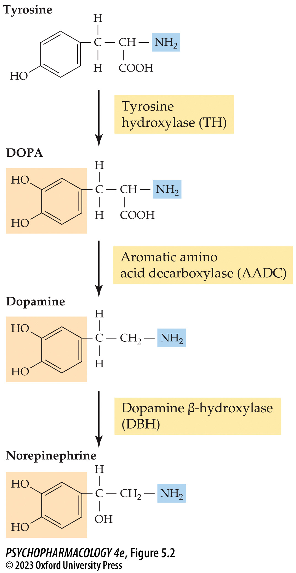
FIGURE 5.2 Multistep pathway of catecholamine synthesis
Notes:
FIGURE 5.2 Multistep pathway of catecholamine synthesis
Catecholamines are synthesized from the precursor amino acid tyrosine. Tyrosine hydroxylase and aromatic amino acid decarboxylase are found in all catecholaminergic neurons, whereas dopamine β-hydroxylase is present only in cells that use norepinephrine as their neurotransmitter.

Slide 9
Catecholamine Synthesis, Release, and Inactivation (3 of 11)
Catecholamines are synthesized by a multistep pathway in which tyrosine hydroxylase catalyzes the rate-limiting step
Catecholamine synthesis can be increased by administering precursors such as tyrosine or l-DOPA, used to treat Parkinson’s disease.
Drugs that reduce synthesis inhibit one of the enzymes; α-methyl-para-tyrosine (AMPT) blocks TH
Notes:
Instructor Notes:

Slide 10
Catecholamine Synthesis, Release, and Inactivation (4 of 11)
Catecholamine storage and release are regulated by vesicular uptake, autoreceptor activity, and cell firing rate
Catecholamines are loaded into synaptic vesicles by vesicular monoamine transporters (VMAT)
VMAT can be blocked by reserpine, an irreversible inhibitor; causes sedation and depressive symptoms
Reversible inhibitors of VMAT are used to reduce uncontrolled movements in Huntington’s disease and tardive dyskinesia.
Notes:
Instructor Notes:
VMAT1 is found in the adrenal medulla, VMAT2 is present in the brain. Both can be blocked by reserpine.
Reversible VMAT2 inhibitors: tetrabenazine (trade name Xenazine), deutetrabenazine (Austedo), and valbenazine (Ingrezza)

Slide 11
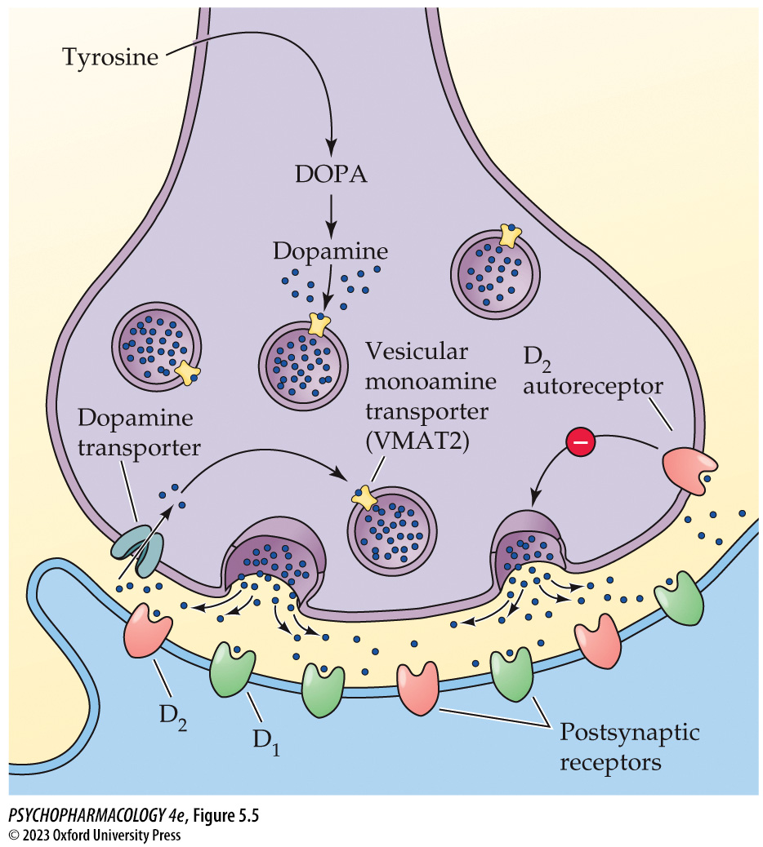
FIGURE 5.5 A typical dopaminergic neuron
Notes:
FIGURE 5.5 A typical dopaminergic neuron
The membrane of its terminals possesses autoreceptors. When these receptors are stimulated, they inhibit sub­sequent DA release by the cell.

Slide 12
Catecholamine Synthesis, Release, and Inactivation (5 of 11)
Catecholamine storage and release are regulated by vesicular uptake, autoreceptor activity, and cell firing rate
Psychostimulants amphetamine and methamphetamine cause release of catecholamines without nerve firing.
Lab animals show increased activity; at high doses stereotyped behaviors occur.
In humans, drug effects include increased alertness, high energy levels, euphoria, insomnia
Notes:
Instructor Notes:
Stereotyped behaviors include intense sniffing, repetitive head and limb movements, and licking and biting.

Slide 13
Catecholamine Synthesis, Release, and Inactivation (6 of 11)
Catecholamine storage and release are regulated by vesicular uptake, autoreceptor activity, and cell firing rate
DA release is inhibited by autoreceptors
Neuron firing pattern also influences DA release:
  Single-spiking mode: action potentials appear at irregular intervals (tonic release)
  Burst mode: trains of 2–20 spikes at higher frequency (phasic release); transmitter release occurring faster than it can be cleared and/or metabolized
Notes:
Instructor Notes:
The autoreceptors inhibit neurotransmitter release through two combined mechanisms: (1) inhibiting action of voltage-gated Ca2+ channels - reduces DA release by directly reducing amount of activity-mediated Ca2+ influx needed for vesicular exocytosis
(2) enhancing the opening of a type of voltage-gated K+ channel - indirectly reduces Ca2+ influx by shortening the duration of action potentials

Slide 14
Catecholamine Synthesis, Release, and Inactivation (7 of 11)
Catecholamine storage and release are regulated by vesicular uptake, autoreceptor activity, and cell firing rate
DA and NE axons form en passant (“in passing”) synapses:
  Fibers have repeated swellings (varicosities) along their length, filled with synaptic vesicles.
  But only 30% of varicosities have release sites for DA; questions regarding their function remain.
Notes:
Instructor Notes:

Slide 15
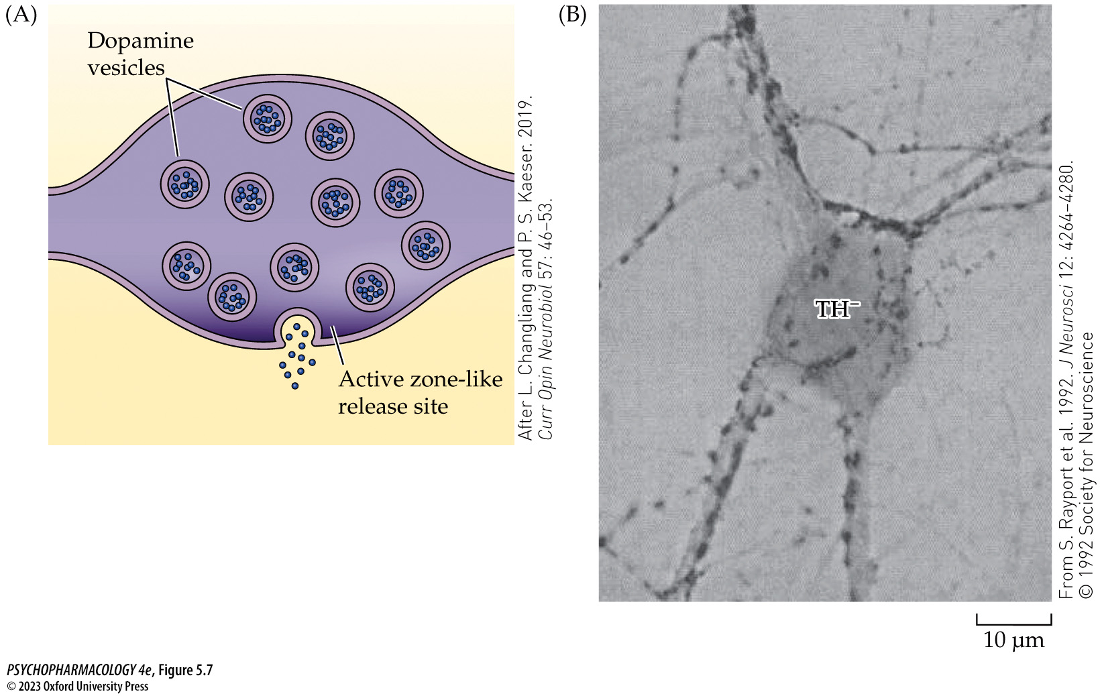
FIGURE 5.7 Varicosities along the lengths of dopaminergic fibers
Notes:
FIGURE 5.7 Varicosities along the lengths of dopaminergic fibers
(A) As depicted in this cartoon, dopaminergic fibers possess intermittent swellings that are filled with synaptic vesicles and that serve as the sites of DA release. (B) This photomicrograph obtained from cultured rat midbrain tissue depicts dopaminergic fibers and their associated varicosities in close proximity to the dendrites and cell body of a non-dopaminergic cell. To obtain the image, tissue from the midbrain of a young rat was removed and the cells were allowed to grow in a Petri dish. Some of the neurons in this brain area synthesize DA, whereas others use a different neurotransmitter. After 21 days in culture, the cells were stained using an antibody to TH, causing any structure containing this enzyme to appear dark in the photomicrograph. Note the large gray cell in the center of the image, which is labeled TH⁻. This means that the cell lacked the TH stain and, therefore, was not a dopaminergic neuron. The relatively thick fibers emanating from the cell body are its dendrites, which are studded with many small dark oblong structures that are TH⁺ (i.e., dopaminergic) varicosities that appear to be making connections with the non-DA neuron’s dendrites. Even axons such as the one in the mid-left region of the photomicrograph that don’t come into proximity with a dendrite still possess varicosities along their length. Finally, note the presence of the 10-μm scale bar at the lower right. This is a common method of showing the size of the cellular structures visible in the image. (A after L. Changliang and P. S. Kaeser. 2019. Curr Opin Neurobiol 57: 46–53.)

Slide 16
Catecholamine Synthesis, Release, and Inactivation (8 of 11)
Catecholamines are recycled after release by a process of reuptake
Reuptake: DA and NE transporters return the transmitters to the releasing cell for breakdown or repackaging into vesicles
Uptake: by postsynaptic cell or glial cells by non-selective transporters
Transporter-blocking drugs enhance DA or NE transmission by increasing the amount of neurotransmitter available
Notes:
Instructor Notes:
Compounds that block both DA and NE reuptake include methylphenidate (Ritalin) and amphetamine (Adderall) –standard treatments for attention-deficit/hyperactivity disorder (ADHD)
Compounds that block NE transporters include atomoxetine (Strattera), a newer ADHD medication, and reboxetine (Edronax), a newer-generation antidepressant drug.
Compounds that block combinations of catecholamine and serotonin (5-HT) reuptake: tricyclic antidepressants, which block the NE and 5-HT transporters, and cocaine, which inhibits reuptake
of all three major monoamine transmitters: DA, NE, and 5-HT.

Slide 17
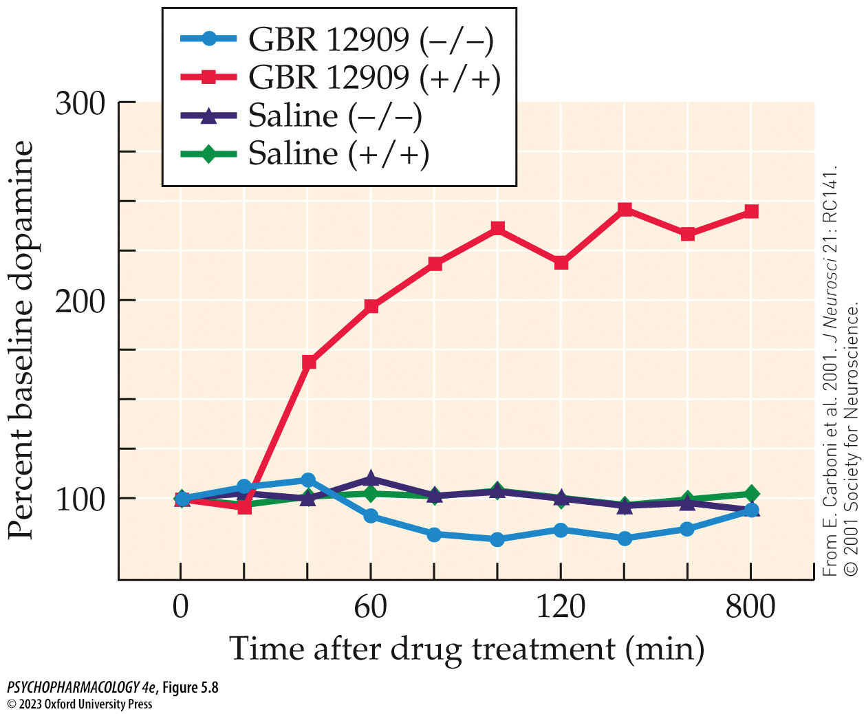
FIGURE 5.8 Extracellular DA levels are strongly elevated by treatment with a DA reuptake inhibitor
Notes:
FIGURE 5.8 Extracellular DA levels are strongly elevated by treatment with a DA reuptake inhibitor
Microdialysis probes were surgically implanted in the nucleus accumbens of mice. Two days later, mice were injected intraperitoneally with either 10 mg/kg of the selective DA reuptake inhibitor GBR 12909 or saline vehicle. Samples of extracellular fluid were collected at 20-minute intervals and analyzed for DA. In genetically intact control mice with two copies of the transporter gene (designated +/+), the inhibitor caused extracellular DA levels to rise to more than 200% of baseline for at least 3 hours. Saline treatment of the control mice showed no change in DA. When mice that had been genetically engineered to eliminate the DA transporter (i.e., DA transporter knockout mice, designated −/−) were given either GBR 12909 or saline, there was no change in extracellular DA levels. This demonstrated that the enhancing effect of GBR 12909 was mediated by its effects on the DA transporter. Note that all DA levels are expressed as percent of the baseline at time 0. This obscures the fact that baseline extracellular DA is markedly increased in the transporter knockout mice because they cannot efficiently remove DA from the extracellular fluid. (From E. Carboni et al. 2001. J Neurosci 21: RC141. © 2001 Society for Neuroscience.)

Slide 18
Catecholamine Synthesis, Release, and Inactivation (9 of 11)
Catecholamine levels are regulated by metabolizing enzymes
Breakdown of catecholamines involves monoamine oxidase (MAO) and catechol-O-methyltransferase (COMT).
Nonselective MAO inhibitors used to treat depression had dangerous side effects.
Selective MAO inhibitors: moclobemide (MAO-A) for depression and Selegiline (Eldepryl) and rasagiline (Azilect) (MAO-B) for Parkinson’s disease.
Notes:
Instructor Notes:
Two types of MAO: MAO-A is expressed by catecholamine neurons; MAO-B is found in other types of neurons and glial cells (astrocytes)
Nonselective MAO inhibitors (block both MAO-A and MAO-B): phenelzine (Nardil) or tranylcypromine (Parnate) – used to treat depression have dangerous side effects.

Slide 19
Catecholamine Synthesis, Release, and Inactivation (10 of 11)
Catecholamine levels are regulated by metabolizing enzymes
COMT acts on compounds containing the catechol structure
Action of MAO and COMT produce metabolites:
  DA metabolite: homovanillic acid (HVA)
  NE metabolites: 3-methoxy-4-hydroxy-phenylglycol (MHPG) in the brain and vanillymandelic acid (VMA) in the PNS.
Levels of metabolites in blood, urine, and CSF provide an indication of catecholaminergic activity.
Notes:
Instructor Notes:
COMT inhibitors to enhance l-DOPA availability in Parkinson’s patients: entacapone (Comtan), opicapone (Ongentys), and tolcapone (Tasmar),

Slide 20
Catecholamine Synthesis, Release, and Inactivation (11 of 11)
CLICKER QUESTION 1
What type of compound would reduce the availability of NE?
l-DOPA
Tyrosine hydroxylase inhibitor
NE transporters
Notes:
Instructor Notes:
Correct answer: b

Slide 21
Review of Learning Objectives (1 of 3)
5.1.1 Describe the processes involved in catecholamine synthesis, storage, and release.
5.1.2 Explain how catecholamines are inactivated, including both reuptake and metabolism.
5.1.3 List and explain the clinical uses of drugs that act on catecholamine reuptake or metabolism.

Slide 22
Organization and Function of the Dopaminergic System (1 of 13)
Two important dopaminergic cell groups are found in the midbrain
A9 in the substantia nigra: axons ascend to the dorsal striatum in the forebrain—the nigrostriatal tract
A10 in the ventral tegmental area (VTA)
  Mesolimbic dopamine pathway: VTA to limbic system
  Mesocortical dopamine pathway: VTA to cerebral cortex
Notes:
Instructor Notes:
A small group of cells in the hypothalamus gives rise to the tuberohypophyseal dopamine pathway; important in controlling secretion of prolactin by the pituitary gland.
There are also DA-containing neurons within sensory structures such as the olfactory bulbs and the retina.

Slide 23
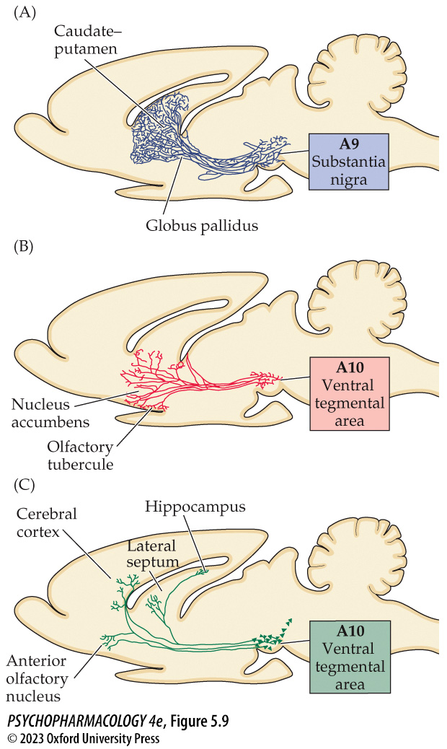
FIGURE 5.9 The ascending DA system can be divided into three pathways
Notes:
FIGURE 5.9 The ascending DA system can be divided into three pathways
The nigrostriatal pathway (A) originates in the substantia nigra (A9 cell cluster) and innervates the caudate–putamen (dorsal striatum). The mesolimbic pathway (B and C) originates in the VTA (A10 cell cluster) and innervates various limbic system structures such as the nucleus accumbens, hippocampus, lateral septum, and amygdala (not shown here). The mesocortical pathway (C) also originates in the VTA and innervates the cerebral cortex. The pathways have been depicted in a sagittal view of a rodent (e.g., rat or mouse) brain for ease in identification.

Slide 24
Organization and Function of the Dopaminergic System (2 of 13)
Ascending dopamine pathways have been implicated in several important behavioral functions
Nigrostriatal tract facilitates voluntary movement.
Research on the motor functions of DA:
  Parkinson’s disease (loss of DA neurons in the substantia nigra)
  Mutations in genes for TH, AADC, tetrahydrobiopterin (TH cofactor) (rare inborn errors of metabolism)
  Experimental lesions of the nigrostriatal tract by neurotoxins
  Mice genetically engineered to lack DA
Notes:
Instructor Notes:
Neurotoxins used for lesioning: 6-hydroxydopamine (6-OHDA) and 1-methyl-4-phenyl-1,2,3,6-tetrahydropyridine (MPTP).

Slide 25
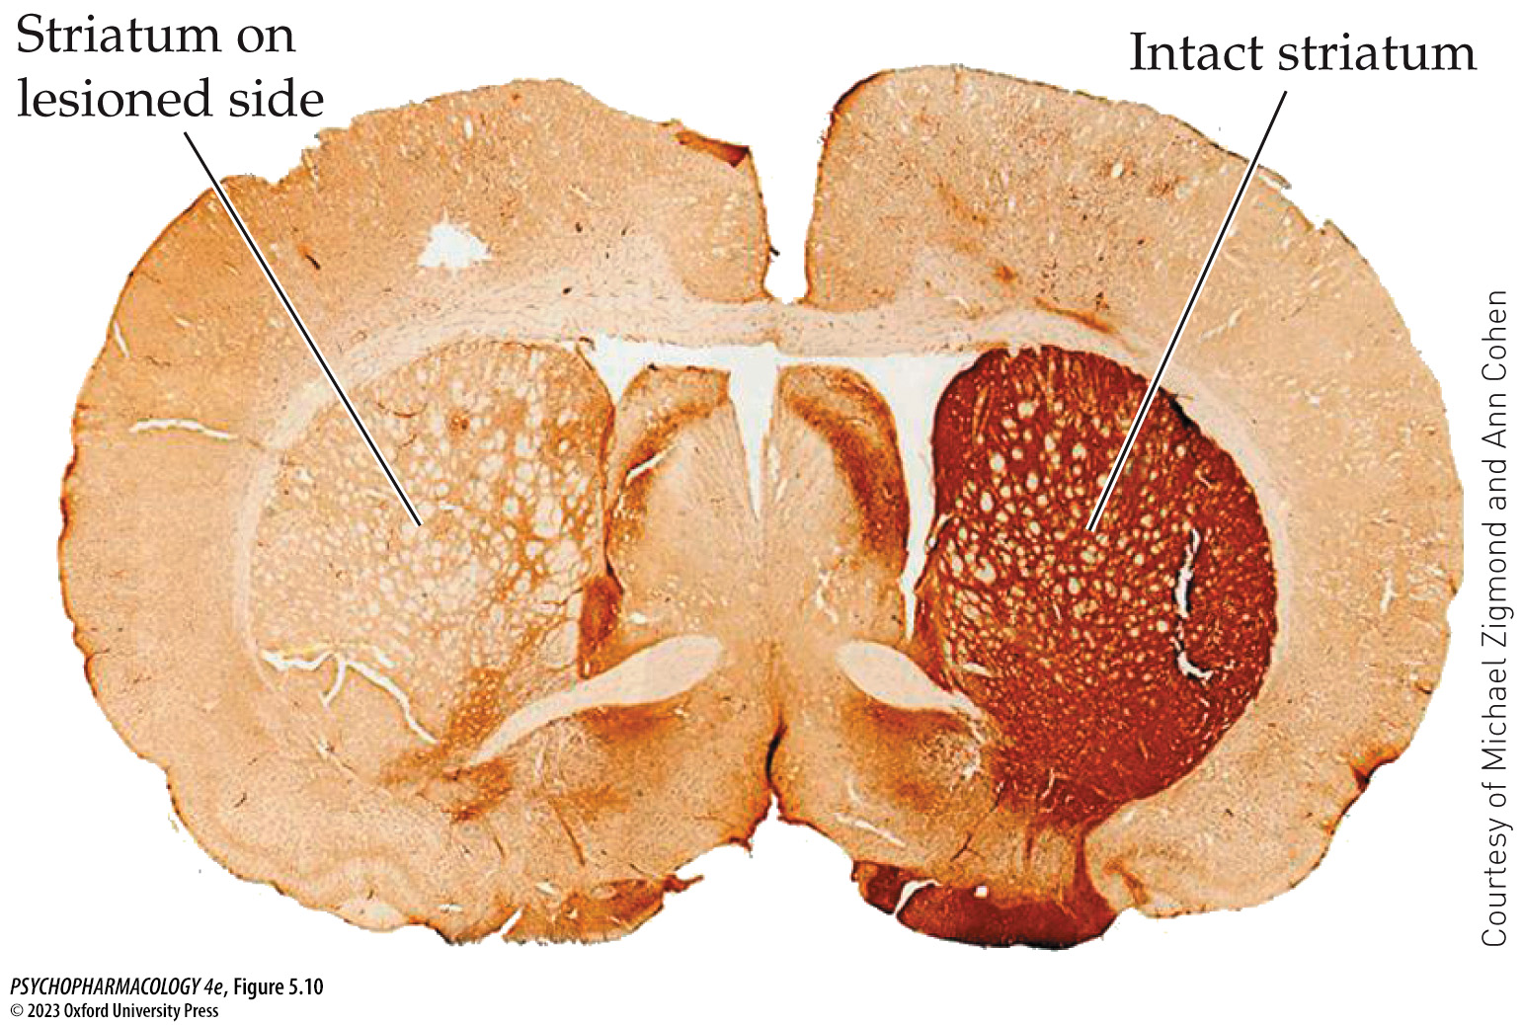
FIGURE 5.10 Unilateral damage to the nigrostriatal pathway
Notes:
FIGURE 5.10 Unilateral damage to the nigrostriatal pathway
Shown here is a photomicrograph of a tissue section from the brain of a rat that had received a unilateral 6-OHDA lesion of the medial forebrain bundle, which contains the axons of the nigrostriatal pathway. The section, which was stained using an antibody against tyrosine hydroxylase, depicts the loss of dopaminergic fibers and terminals in the striatum on the side of the lesion.

Slide 26
Organization and Function of the Dopaminergic System (3 of 13)
Ascending dopamine pathways have been implicated in several important behavioral functions
Dopamine-deficient (DD) mouse: gene for TH is knocked out but not the gene for DBH – NE can be synthesized but not DA.
DD mice exhibit severe aphagia (lack of feeding behavior), adipsia (lack of drinking), and hypoactivity; behaviors can be restored by l-DOPA.
Mouse models confirmed a critical role for the dorsal striatum in many of the activational, motivational, and cognitive functions of DA.
Notes:
Instructor Notes:

Slide 27
Organization and Function of the Dopaminergic System (4 of 13)
Ascending dopamine pathways have been implicated in several important behavioral functions
Mesolimbic dopamine pathway activates arousal and locomotor behavior; different neurons mediate the effects of rewarding and aversive stimuli.
Mesocortical pathway: input to the PFC helps regulate cognitive functions such as attention and working memory.
  COMT metabolizes DA in the PFC; a point mutation in the COMT gene makes the enzyme less active which may influence working memory in adults.
Notes:
Instructor Notes:

Slide 28
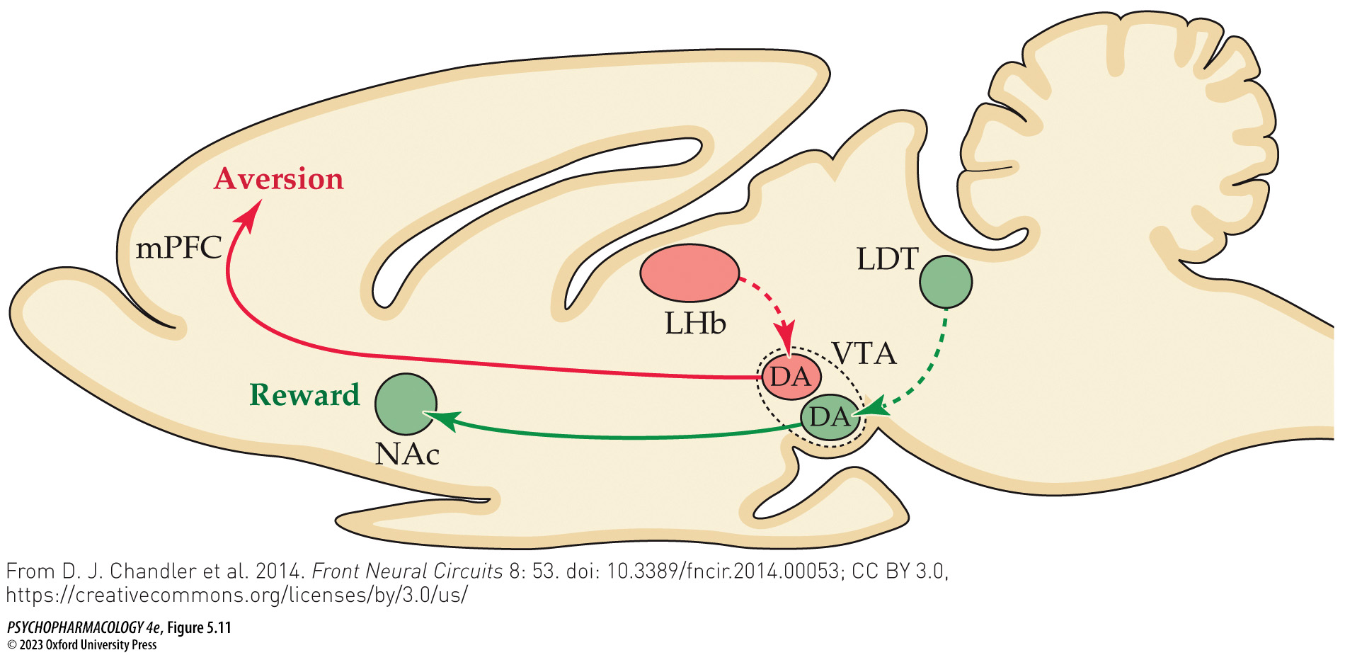
FIGURE 5.11 Different subsets of VTA dopaminergic neurons mediate the effects of rewarding versus aversive stimuli
Notes:
FIGURE 5.11 Different subsets of VTA dopaminergic neurons mediate the effects of rewarding versus aversive stimuli
The diagram depicts a sagittal section through a rodent brain illustrating the features of VTA dopaminergic neurons that help encode rewarding versus aversive stimuli. The reward-mediating pathway (green) includes input to the VTA from the laterodorsal tegmentum (LDT) and dopaminergic output from the VTA to the nucleus accumbens (NAc). The aversion-mediating pathway (red) includes input to the VTA from the lateral habenula (LHb) and dopaminergic output from the VTA to the medial prefrontal cortex (mPFC). (From D. J. Chandler et al. 2014. Front Neural Circuits 8: 53. doi: 10.3389/fncir.2014.00053; CC BY 3.0, https://creativecommons.org/licenses/by/3.0/us/)

Slide 29
Organization and Function of the Dopaminergic System (5 of 13)
There are five main subtypes of dopamine receptors organized into D₁- and D₂-like families
All are metabotropic receptors; D₁ and D₂ are most common
D₁ receptors stimulate adenylyl cyclase – increasing the rate of cAMP synthesis
D₂ receptors inhibit adenylyl cyclase – decreasing the rate of cAMP synthesis
D₂ receptors also regulate membrane ion channels for K+
Notes:
Instructor Notes:
Metabotropic receptors interact with G proteins and function through second messengers.
D₁ and D₅ are similar (D₁-like receptors). D₂, D₃, and D₄ are a separate family (D₂-like receptors).

Slide 30
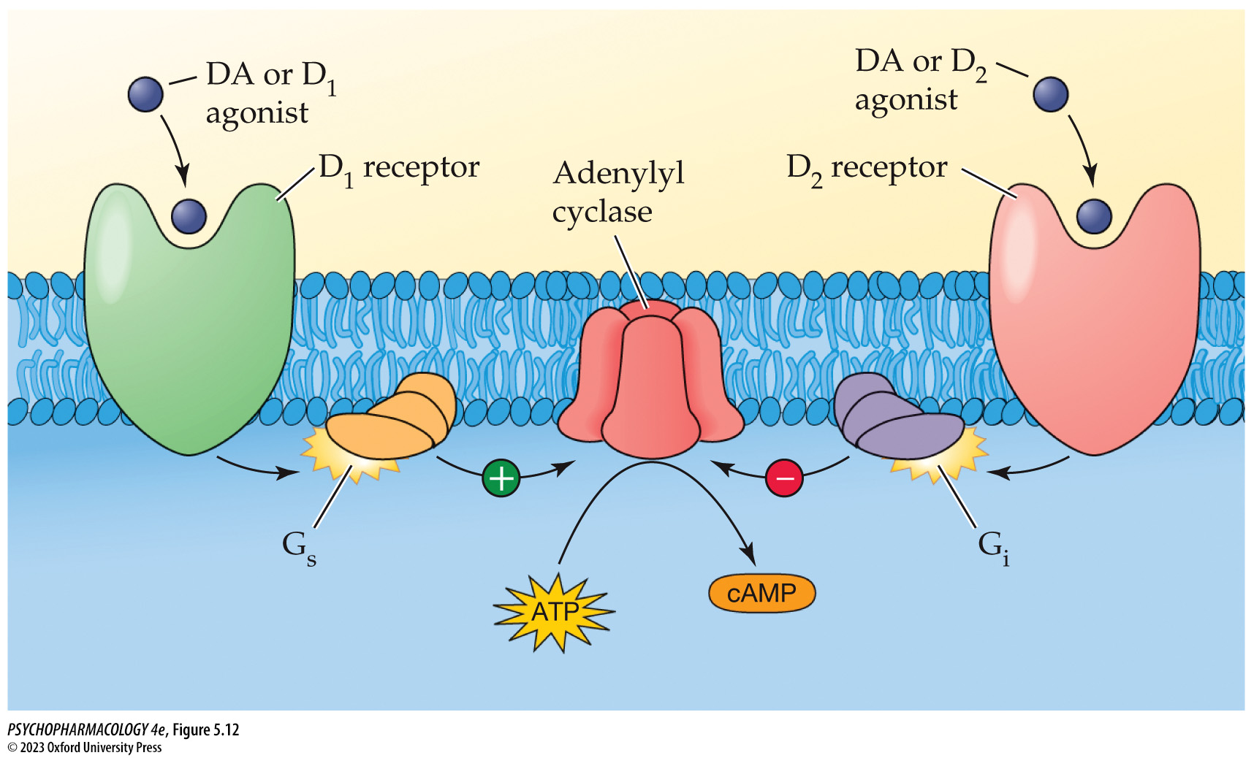
FIGURE 5.12 Signaling mechanisms of D₁ and D₂ receptors
Notes:
FIGURE 5.12 Signaling mechanisms of D₁ and D₂ receptors
Activation of D₁ receptors stimulates the enzyme adenylyl cyclase and enhances DA synthesis, whereas activation of D₂ receptors inhibits adenylyl cyclase and decreases DA synthesis. These effects are produced by the activation of different G proteins in the postsynaptic cell membrane, namely G_{s} for the D₁ receptor and G_{i} for the D₂ receptor.

Slide 31
Organization and Function of the Dopaminergic System (6 of 13)
There are five main subtypes of dopamine receptors organized into D₁- and D₂-like families
D₂ receptors have a higher affinity for DA than D₁ receptors
Hypothesis: tonic DA release activates higher-affinity D₂ receptors; increase in DA levels produced by phasic release additionally activates the lower-affinity D₁ receptors.
D₂ receptors also function as autoreceptors: terminal D₂ auto-receptors reduce DA release; somatodendritic D₂ autoreceptors inhibit dopaminergic cell firing.
Notes:
Instructor Notes:

Slide 32
Organization and Function of the Dopaminergic System (7 of 13)
Dopamine receptor agonists and antagonists affect locomotor activity, motor control, and other behavioral functions
Apomorphine: agonist that stimulates D₁ and D₂ receptors; causes behavioral activation
Receptor-selective agonists and antagonists are used to determine which behaviors are under the control of particular receptor subtypes.
SKF 38393: D₁ agonist used in animal research but has adverse clinical side effects and development of tachyphylaxis
Notes:
Instructor Notes:
A relatively new use for apomorphine is treating erectile dysfunction in men (trade name Uprima).
Tachyphylaxis: a form of rapid tolerance involving diminished responses following repeated drug dosing.

Slide 33
Organization and Function of the Dopaminergic System (8 of 13)
Dopamine receptor agonists and antagonists affect locomotor activity, motor control, and other behavioral functions
DETQ: allosteric modulator of D₁ receptors; no tolerance development
Quinpirole: D₂/D₃ receptor agonist
Other D₂/D₃ agonists have clinical applications: bromocriptine (Parlodel and Cycloset) reduces symptoms of Parkinson’s disease and hyperprolactinemia
Notes:
Instructor Notes:
Three other clinically used D₂/D₃ agonists are pramipexole (Mirapex), ropinirole (Requip), and rotigatine (Neupro); for Parkinson’s and restless legs syndrome.
Hyperprolactinemia: excessive prolactin blood levels

Slide 34
Organization and Function of the Dopaminergic System (9 of 13)
Dopamine receptor agonists and antagonists affect locomotor activity, motor control, and other behavioral functions
DA receptor antagonists suppress locomotor behavior; at high doses catalepsy can result.
Catalepsy can be induced by haloperidol, or D₁ blockers such as SCH23390
D₂ antagonists are used to treat schizophrenia but have motor side effects.
Notes:
Instructor Notes:

Slide 35
Organization and Function of the Dopaminergic System (10 of 13)
Dopamine receptor agonists and antagonists affect locomotor activity, motor control, and other behavioral functions
Long term use of D₂ antagonist such as haloperidol can cause behavioral supersensitivity (animal is super sensitive to a D₂ agonist).
Due in part to up-regulation of D₂ receptors by postsynaptic neurons in areas such as the striatum
May occur in patients following continuous administration of a D₂ antagonist.
Notes:
Instructor Notes:

Slide 36
Organization and Function of the Dopaminergic System (11 of 13)
BOX 5.1 THE CUTTING EDGE
Using Molecular Genetics to Study the Dopaminergic System
Researchers can now create “conditional” knockouts or knockins in adult animals.
DA transporter knockout animals are extremely hyperactive because of the persistent activation of DA receptors; also cognitive deficits and impulsivity, traits often seen in children suffering from ADHD.
Notes:
Instructor Notes:

Slide 37
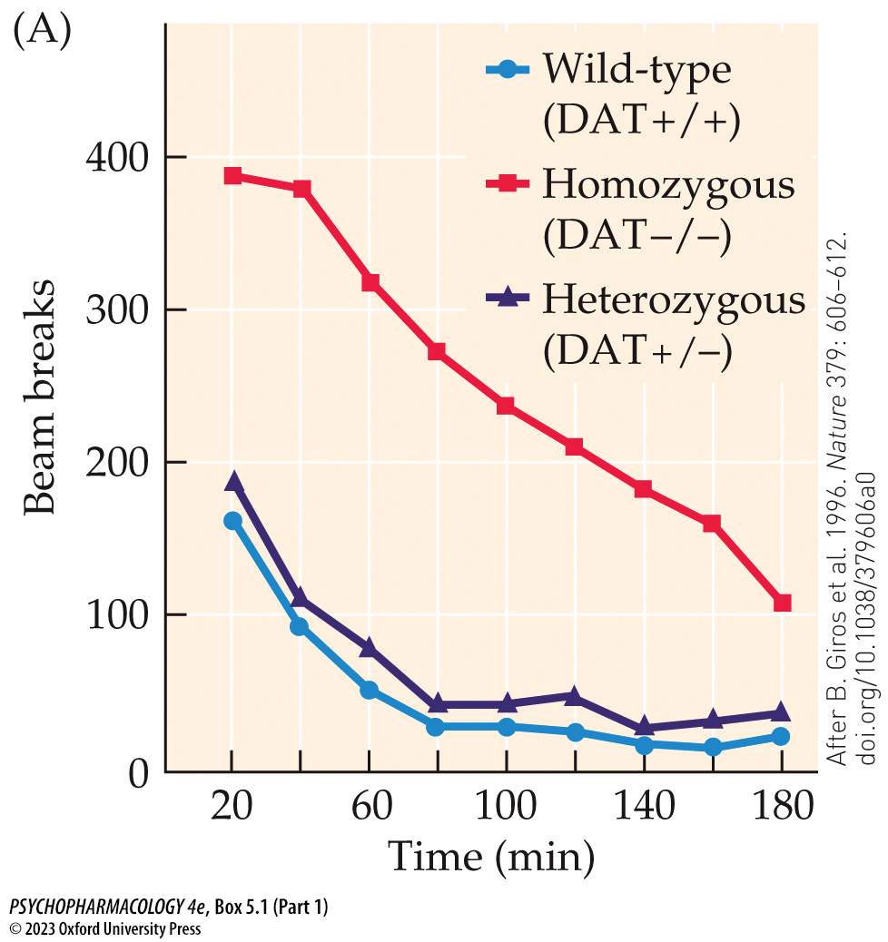
Box 5.1 The Cutting Edge: Using Molecular Genetics to Study the Dopaminergic System (Part 1)
Notes:
Box 5.1 The Cutting Edge: Using Molecular Genetics to Study the Dopaminergic System
FIGURE A Dopamine transporter (DAT) knockout mice show increased locomotor activity
Mutant mice lacking a functional DAT (homozygous DAT−/−) were compared with wild-type mice (DAT+/+) and with heterozygous mice (DAT+/−) that carry one functional copy of the DAT gene. Mice were tested in a photo­cell apparatus, and the number of photobeam breaks was recorded every 20 minutes for a total of 3 hours. All groups showed a gradual habituation to the apparatus, as indicated by decreasing beam breaks over time, but the activity of the DAT knockout mice (DAT−/−) was consistently higher than that of the other two groups. (After B. Giros et al. 1996. Nature 379: 606–612. doi.org/10.1038/379606a0)

Slide 38
Organization and Function of the Dopaminergic System (12 of 13)
BOX 5.1 THE CUTTING EDGE (cont.)
Using Molecular Genetics to Study the Dopaminergic System
D₁ and D₂ receptor knockout mice are insensitive to the locomotor-stimulating effects of psychostimulants such as cocaine.
Mutant mice that overexpress DA transporter show an exaggerated locomotor response to amphetamine.
Both the DA transporter and D₁ and D₂ receptors play pivotal roles in the behavior-stimulating effects of cocaine and amphetamine
Notes:
Instructor Notes:

Slide 39
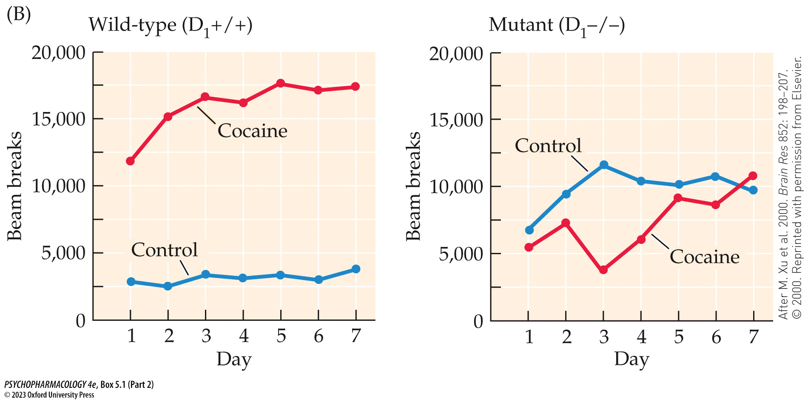
Box 5.1 The Cutting Edge: Using Molecular Genetics to Study the Dopaminergic System (Part 2)
Notes:
Box 5.1 The Cutting Edge: Using Molecular Genetics to Study the Dopaminergic System
FIGURE B D1 receptor knockout mice show decreased reaction to a psychostimulant drug
Mutant mice lacking D₁ receptors (D₁−/−) are insensitive to the locomotor-stimulating effects of cocaine. Wild-type (D₁+/+) and homozygous mutant mice were injected twice daily for 7 consecutive days with either cocaine (20 mg/kg intraperitoneally) or a saline control solution. The animals were tested in a photocell apparatus for 30 minutes after each injection to record their locomotor activity. Cocaine greatly increased locomotor activity in the wild-type but not the mutant mice on all test days. (After M. Xu et al. 2000. Brain Res 852: 198–207. © 2000. Reprinted with permission from Elsevier.)

Slide 40
Organization and Function of the Dopaminergic System (13 of 13)
CLICKER QUESTION 2
The dopaminergic neurons originate in which two regions?
Ventral tegmental area, locus coeruleus
Substantia nigra, locus coeruleus
Substantia nigra, ventral tegmental area
Ventral tegmental area, nucleus accumbens
Notes:
Instructor Notes:
Correct answer: c

Slide 41
Review of Learning Objectives (2 of 3)
5.2.1 Name the major ascending dopaminergic pathways that originate in the midbrain, and identify the locations of the cell bodies and the projection areas of each pathway.
5.2.2 Explain the role of DA in behavioral regulation, including the initiation and control of voluntary movement, responses to rewarding stimuli, and cognitive functioning.
5.2.3 Describe the family of DA receptors, including the various subtypes, signaling mechanisms, and roles as both postsynaptic receptors and autoreceptors.
5.2.4 Describe the behavioral and physiological effects of DA receptor agonists and antagonists, including their clinical applications where relevant.

Slide 42
Organization and Function of the Noradrenergic System (1 of 11)
Norepinephrine is an important transmitter in both the central and peripheral nervous systems
NE neurons in the brain are located in the pons and medulla, especially in the locus coeruleus (LC)
All neurons in the LC express the enzyme DBH and synthesize NE
LC sends fibers to almost all areas of the forebrain – many involved in sensory information processing; also to the cerebellum and spinal cord.
Notes:
Instructor Notes:

Slide 43
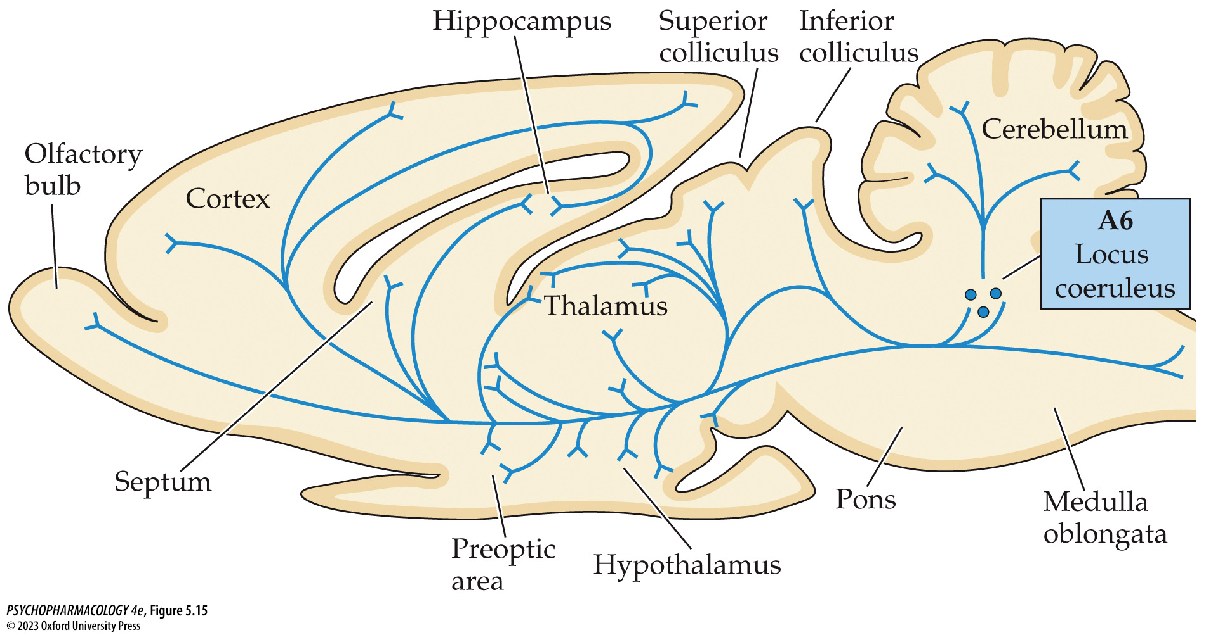
FIGURE 5.15 The locus coeruleus (LC) sends fibers to much of the brain
Notes:
FIGURE 5.15 The locus coeruleus (LC) sends fibers to much of the brain
The LC contains a dense cluster of noradrenergic neurons designated the A6 cell group. These cells send their fibers to almost all regions of the forebrain, as well as to the cerebellum and spinal cord.

Slide 44
Organization and Function of the Noradrenergic System (2 of 11)
Norepinephrine is an important transmitter in both the central and peripheral nervous systems
NE in the PNS: neurons that have cell bodies in ganglia of the sympathetic nervous system use NE
NE functions as a hormone secreted by the adrenal glands; thus NE can reach organs in two ways
Bloodborne NE and EPI work together with NE released from sympathetic nerve endings to mediate the “fight-or-flight” response
Notes:
Instructor Notes:

Slide 45
Organization and Function of the Noradrenergic System (3 of 11)
Norepinephrine and epinephrine act through α- and β-adrenergic receptors
Adrenergic receptors (adrenoceptors) are metabotropic
β₁- and β₂- receptors stimulate adenylyl cyclase and enhance formation of cAMP.
α₂-receptors inhibit adenylylcyclase and reduce the rate of cAMP synthesis; also increase opening of K+ channels
α₁ receptors use the phosphoinositide second-messenger system
Notes:
Instructor Notes:

Slide 46
Organization and Function of the Noradrenergic System (4 of 11)
Norepinephrine and epinephrine act through α- and β-adrenergic receptors
α₂-agonists such as clonidine (Catapres) and lofexidine (Lucemyra) can treat symptoms of opioid withdrawal by stimulating α₂-autoreceptors to inhibit noradrenergic cell firing
The α₂-antagonist yohimbine blocks the autoreceptors, increasing noradrenergic cell firing and NE release; provokes withdrawal symptoms and drug craving
NE may promote feelings of anxiety: tested with human-sized elevated plus maze
Notes:
Instructor Notes:

Slide 47
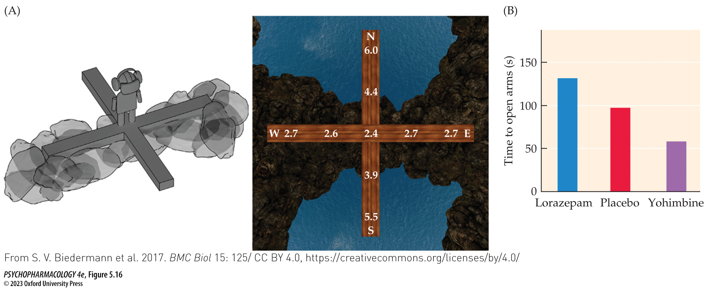
FIGURE 5.16 Effects of pro- and anti-anxiety drugs on open-arm time in the humanized elevated plus-maze
Notes:
FIGURE 5.16 Effects of pro- and anti-anxiety drugs on open-arm time in the humanized elevated plus-maze
Healthy men and women (age 18–50 years) were tested for the amount of time spent in the open arms of a humanized version of the elevated plus-maze test of anxiety-like behavior. (A) The maze consisted of a wooden platform with arm dimensions of 30 cm width, 175 cm length, and 20 cm height, placed on the floor of the laboratory (left). During testing, the participants found themselves in a virtual reality consisting of a mountainous environment in which the “closed” arms (oriented E–W) appeared to be surrounded by rocks, whereas the “open” arms (oriented N–S) appeared to reach out over water that was placed visually about 55 m below (right). Note that the rocks depicted on the left-hand diagram were only visible in the virtual environment. Participants were permitted to physically explore the simulated environment and spend time in the open or closed arms for a total of 300 s. The numbers shown on the arms are the mean reported anxiety levels (on a 0–9 scale with 9 representing very strong anxiety) at each position on the maze. (B) Administration of the α₂-adrenoceptor antagonist yohimbine significantly reduced the amount of time spent in the open arms compared to placebo (indicating increased anxious behavior), whereas the antianxiety GABAergic drug lorazepam significantly increased the amount of time spent in the open arms. (From S. V. Biedermann et al. 2017. BMC Biol 15: 125/CC BY 4.0, https://creativecommons.org/licenses/by/4.0/)

Slide 48
Organization and Function of the Noradrenergic System (5 of 11)
The central noradrenergic system plays a significant role in arousal, cognition, and the consolidation of emotional memories
Arousal: LC neurons fire more rapidly during waking than during sleep, and trigger arousal
α₁-receptor agonist phenylephrine injected into the lateral hypothalamic area increased awake time in rats; the β-receptor agonist isoproterenol had less effect; together they had an additive effect
Notes:
Instructor Notes:

Slide 49
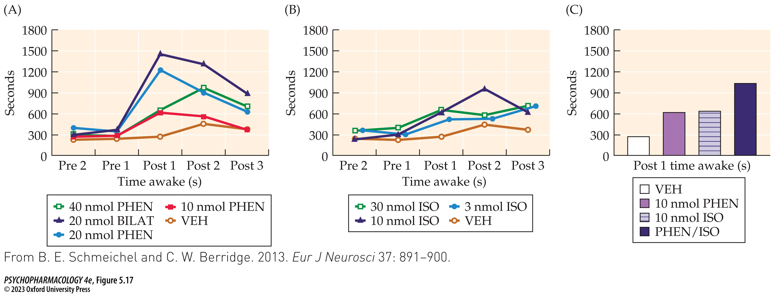
FIGURE 5.17 Wakefulness-promoting effects of adrenergic agonists infused into the lateral hypothalamic area
Notes:
FIGURE 5.17 Wakefulness-promoting effects of adrenergic agonists infused into the lateral hypothalamic area
Rats were given infusions of varying doses of the α₁-agonist phenylephrine (PHEN) and/or the β-agonist isoproterenol (ISO) directly into the lateral hypothalamic area. Control injections were of the vehicle (VEH) used to dissolve the active drugs. Behavioral state (awake or asleep) was determined for two 30-minute intervals prior to drug administration (Pre 1 and Pre 2) as well as three 30-minute postdrug intervals (Post 1, Post 2, and Post 3). All animals received unilateral infusions except for one group denoted as BILAT. (A) Infusions of PHEN alone markedly increased the amount of time spent awake, with the largest effect seen in the 20-nanomole (20 nmol) BILAT group. (B) Infusions of ISO alone exerted a modest effect on time spent awake, with a significant increase only seen in the 30 nmol ISO group. (C) Infusions of 10 nmol PHEN or ISO individually produced nonsignificant increases in time spent awake; however, infusion of both drugs together at the same doses produced a larger, statistically significant increase in waking time. (From B. E. Schmeichel and C. W. Berridge. 2013. Eur J Neurosci 37: 891–900.)

Slide 50
Organization and Function of the Noradrenergic System (6 of 11)
The central noradrenergic system plays a significant role in arousal, cognition, and the consolidation of emotional memories
LC also projects to the PFC, which expresses α₁-, α₂-, and β-receptors; facilitates cognition
An α₂-receptor agonist such as clonidine or guanfacine enhances working memory; activation of α₁-receptors (lower affinity) decreases cognitive functions
Optimal cognitive function occurs at moderate amounts of NE release
Notes:
Instructor Notes:

Slide 51
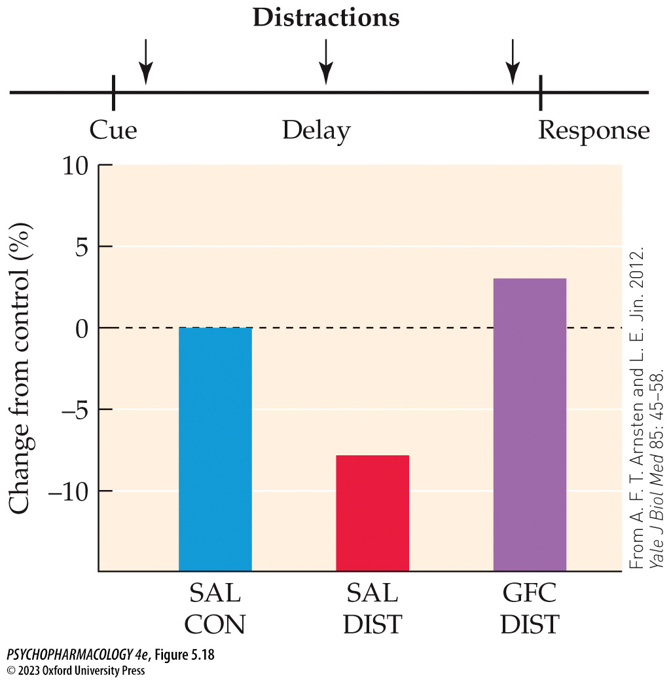
FIGURE 5.18 Guanfacine facilitation of working memory in aged monkeys
Notes:
FIGURE 5.18 Guanfacine facilitation of working memory in aged monkeys
Working memory was tested in aged rhesus monkeys using a two-choice spatial delayed response task. This task requires that the animals remember the location of a food treat with a delay period interposed between presentation of the treat and the opportunity to make a response. Distracting stimuli can be presented during the delay period to determine their influence on response accuracy. The first two bars demonstrate that in monkeys given saline vehicle (SAL), distracters impaired working memory performance (SAL/DIST) compared to the no-distracter control condition (SAL/CON). The third bar shows that guanfacine administration abolished the deleterious effect of the distracters (GFC/DIST) and returned performance to the control condition or slightly better. (From A. F. T. Arnsten and L. E. Jin. 2012. Yale J Biol Med 85: 45–58.)

Slide 52
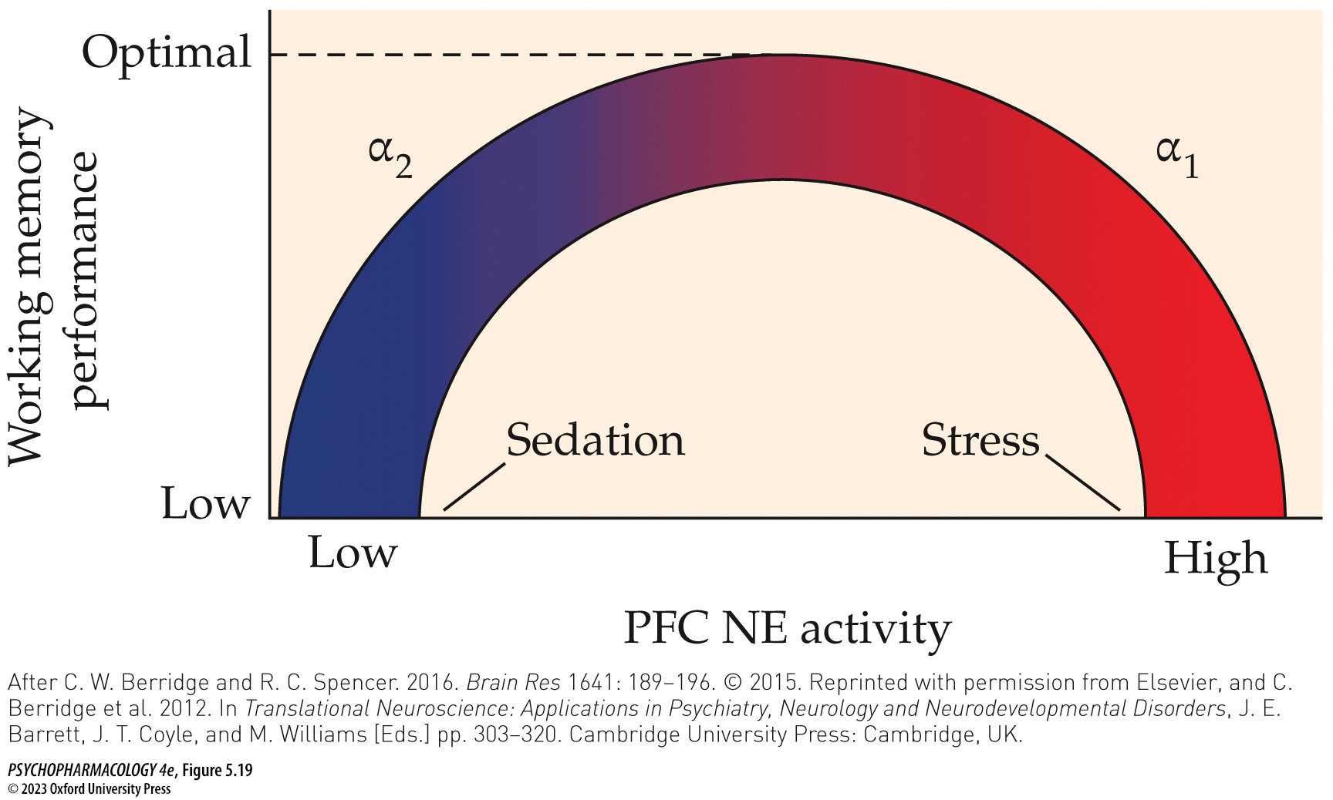
FIGURE 5.19 Modulation of arousal and working memory by adrenergic receptor subtypes in the prefrontal cortex
Notes:
FIGURE 5.19 Modulation of arousal and working memory by adrenergic receptor subtypes in the prefrontal cortex
The figure depicts an inverted U-shaped curve relating arousal and working memory function to noradrenergic activity in the prefrontal cortex (PFC). Activation of high-affinity α₂-adrenoceptors increases arousal and facilitates working memory, whereas activation of lower-affinity α₁-receptors has the opposite effect. Consequently, abnormally low levels of noradrenergic activity in the PFC, which can be caused by certain drugs or by locus coeruleus lesions, result in behavioral sedation and impaired working memory. These effects are due to understimulation of α₂-adrenoceptors, since they can be reversed by selective activation of this receptor subtype. On the other hand, abnormally high levels of noradrenergic activity in the PFC, which can be caused by stress, activate the α₁-receptors and result in memory impairment. Optimal working memory is, therefore, predicted to occur at intermediate levels of PFC noradrenergic activity. (After C. W. Berridge and R. C. Spencer. 2016. Brain Res 1641: 189–196. © 2015. Reprinted with permission from Elsevier, and C. Berridge et al. 2012. In Translational Neuroscience: Applications in Psychiatry, Neurology and Neurodevelopmental Disorders, J. E. Barrett, J. T. Coyle, and M. Williams [Eds.] pp. 303–320. Cambridge University Press: Cambridge, UK.)

Slide 53
Organization and Function of the Noradrenergic System (7 of 11)
The central noradrenergic system plays a significant role in arousal, cognition, and the consolidation of emotional memories
Stress associated with one-trial passive avoidance learning produces increased EPI and glucocorticoid secretion from the adrenal glands plus activation of LC neurons and increased release of NE
A key brain structure is the basolateral amygdala (BLA). The amygdala also plays a role in other types of fear conditioning.
Notes:
Instructor Notes:
Passive avoidance learning – an experimental approach to study consolidation of emotional memories

Slide 54
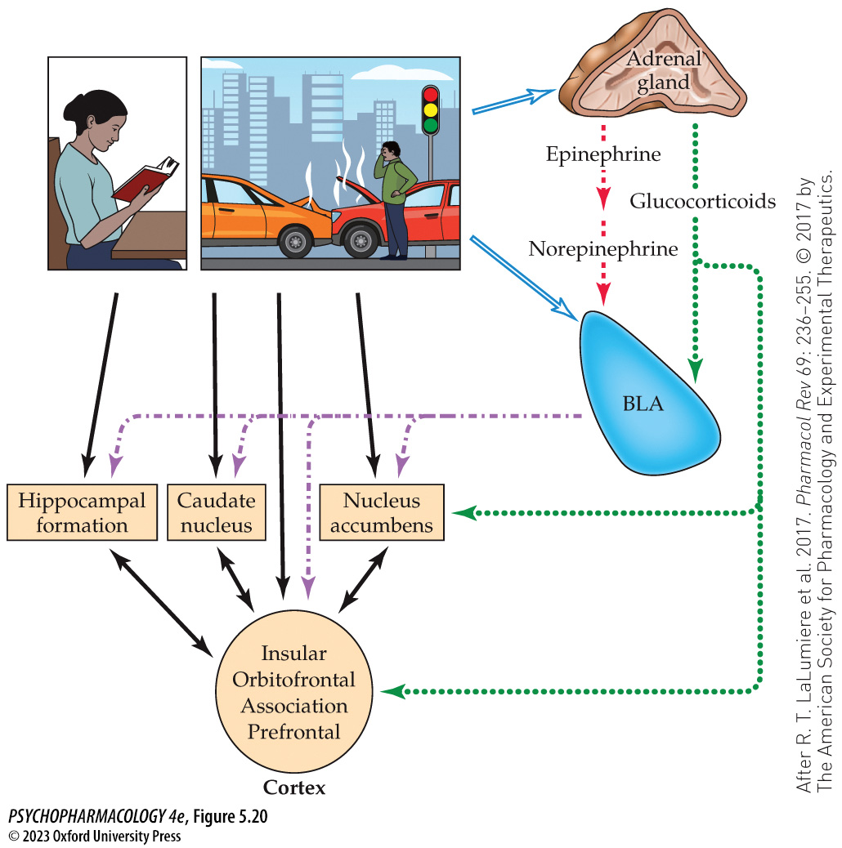
FIGURE 5.20 Hypothesized mechanism of emotional memory consolidation
Notes:
FIGURE 5.20 Hypothesized mechanism of emotional memory consolidation
Studies primarily using laboratory animals suggest that consolidation of emotional memories involves the neural circuit depicted in the diagram. The black solid arrows indicate that learned infor­ma­tion from any type of event (arousing or not) is processed by various parts of the circuit, depending on the kind of learning involved. If, however, the event is emotionally arousing, it additionally elicits activation of the basolateral amygdala (BLA) and increased release of epinephrine and glucocorticoids (corticosterone in rodents, cortisol in humans) from the adrenal glands (blue open arrows). Epinephrine acts at a peripheral site to signal release of NE by LC noradrenergic fibers terminating in the BLA (red dashed arrows). Glucocorticoids freely enter the brain to coordinate with NE in the BLA and to additionally modulate information processing in other brain areas shown in the diagram (green dotted arrows). Lastly, projections from the BLA to the memory-processing system (purple dash-dotted arrows) strengthen the consolidation process, resulting in longer-lasting and more vivid recall of the emotional event. (After R. T. LaLumiere et al. 2017. Pharmacol Rev 69: 236–255. © 2017 by The American Society for Pharmacology and Experimental Therapeutics.)

Slide 55
Organization and Function of the Noradrenergic System (8 of 11)
Several medications work by stimulating or inhibiting peripheral adrenergic receptors
Asthma and COPD: treated with β₂-adrenoceptor agonists including albuterol (Ventolin) and levalbuterol (Xopenex)
The α₁-receptor agonist phenylephrine is an ingredient in OTC decongestant medications – constricts blood vessels
α₂-receptor agonists such as clonidine treat hypertension by inhibiting the sympathetic nervous system while stimulating the parasympathetic system.
Notes:
Instructor Notes:

Slide 56
Organization and Function of the Noradrenergic System (9 of 11)
Several medications work by stimulating or inhibiting peripheral adrenergic receptors
Dexmedetomidine (Precedex): α₂-agonist with combined sedative, anxiolytic, and analgesic effects
Isoproterenol (Isuprel): β-receptor agonist; treats bradycardia
Yohimbine (Yocon): α₂-antagonist; treats male sexual impotence
Prazosin (Minipress): α₁-antagonist; treats hypertension by dilating blood vessels
Notes:
Instructor Notes:

Slide 57
Organization and Function of the Noradrenergic System (10 of 11)
Several medications work by stimulating or inhibiting peripheral adrenergic receptors
Propranolol (Inderal): β-antagonist; treats hypertension by blocking β-receptors in the heart, reducing its contractile force
β₁-selective antagonists such as metoprolol (Lopressor) have fewer side effects
Midodrine (ProAmatine) and metaraminol (Aramine): α₁-agonists; treat hypotension
Propranolol and other β-antagonists (beta blockers) are also used to treat generalized anxiety disorder
Notes:
Instructor Notes:

Slide 58
Organization and Function of the Noradrenergic System (11 of 11)
CLICKER QUESTION 3
Which type of adrenoceptor uses the phosphoinositide second-messenger system?
α₁ subtype receptors
α₂ subtype receptors
β₁ subtype receptors
β₂ subtype receptors
Notes:
Instructor Notes:
Correct answer: a

Slide 59
Review of Learning Objectives (3 of 3)
5.3.1 Identify the primary source of forebrain NE, the main target areas innervated by noradrenergic fibers, and the physiological effects of peripheral NE originating in the sympathetic nervous system and the adrenal glands.
5.3.2 List the adrenergic receptor subtypes and their respective signaling mechanisms.
5.3.3 Explain the mechanisms by which the noradrenergic system helps regulate anxiety, arousal, cognition, and the consolidation of emotional memories.
5.3.4 Identify medical conditions or disorders that can be treated with peripherally acting noradrenergic drugs, and name the drugs used for these disorders.

